Slide 1
Frequency and duty cycle calculator
Made by:
Aly Ehab El-Hamalawy

Slide 2
outline
Main idea
Block diagram
code

Slide 3
Main idea
The main idea of the project is to generate a pwm wave, and from it we should calculate the frequency and duty cycle. By using timer 0 to generate the pwm wave and timer1 to calculate the frequency and duty cycle.

Slide 4
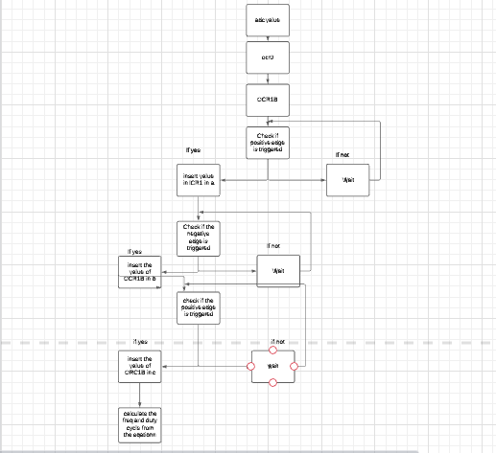
Block diagram

Slide 5
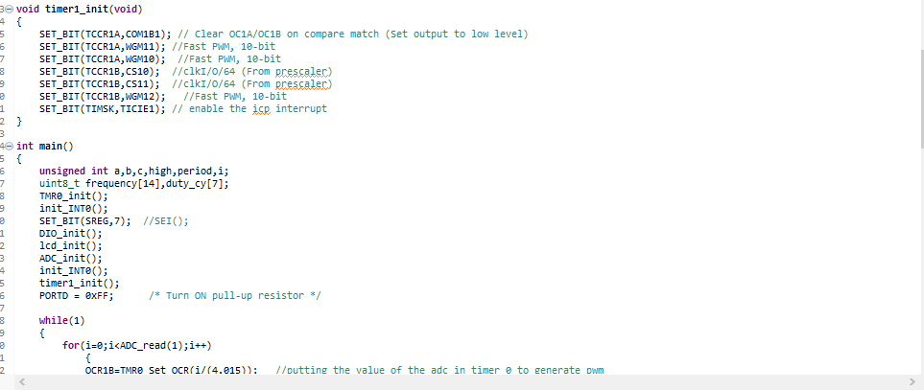
code

Slide 6
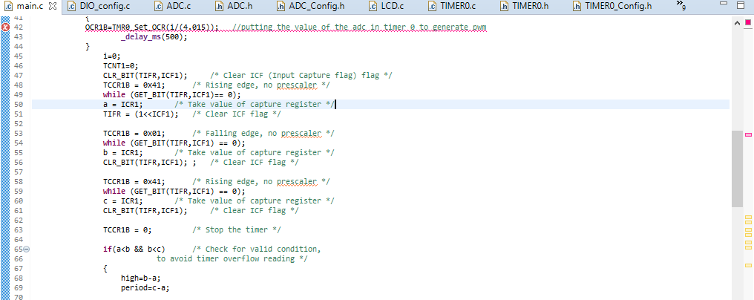
code

Slide 7
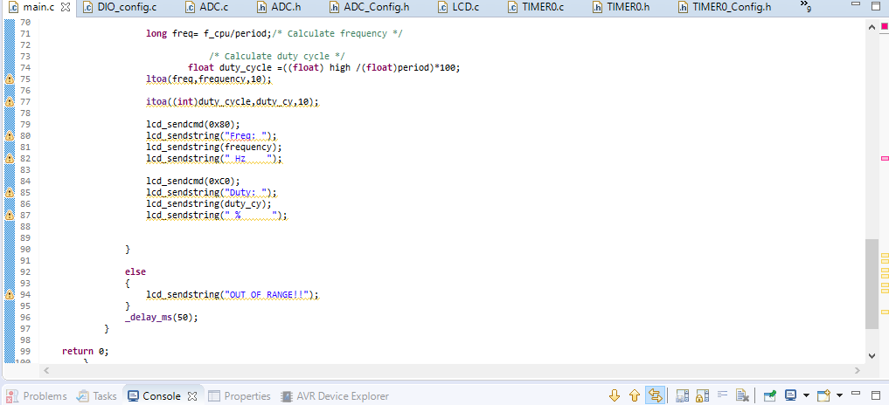
code

